Slide 1
Lecture 4
Sequences and iterators
EECS-214

Slide 2
Memory structure
Ultimately, the computer’s memory is one big array of bytes
Objects are represented by discrete chunks of the array
  Identified by the location (address) within the array
Memory management is the process of keeping track of
  Which chunks are used to represent which objects
  Which chunks are free (available to allocation)

Slide 3
Statically allocated structures
Memory management makes it easy to allocate chunks
  But hard to grow or shrink them after allocation
So all data structures are ultimately built out of static-sized chunks
Arrays
  Fast
  Let you access elements by number
  Can’t be resized
Record structures (classes, structs)
  Fields accessed by name rather than number
  Set of fields is fixed at compile time
  Compiler effectively turns field references into array references

Slide 4
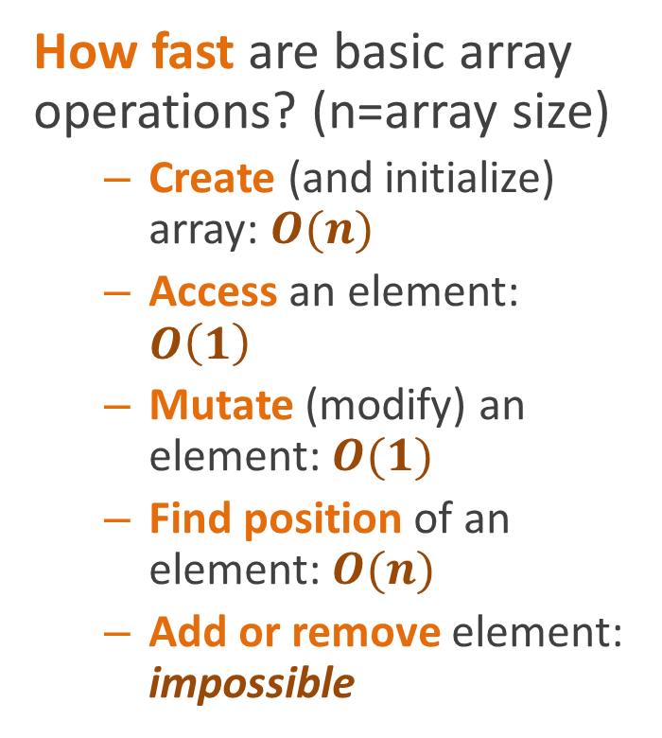
Performance profile of arrays
How fast are basic array operations? (n=array size)
  Create (and initialize) array: $O(n)$
  Access an element: $O\left(1\right)$
  Mutate (modify) an element: $O(1)$
  Find position of an element: $O(n)$
  Add or remove element: impossible
int[] a;

Slide 5
Dynamic structures
If we want to add or remove elements, we have to be fancier
Preallocate a fixed amount
  Only use as much as you need at the moment
  Throw an exception if you run out of space
Indirection
  Store data in a normal array
  Represent sequence object as a pointer to the array
  Replace it with a whole new array when you need to change size
Chained structures
  Break structure into chunks
  Each chunk points to next chunk
  Resize by adding or removing chunks
  Examples
    Linked lists
    Files on disk
!
a
b
c
d
e
f
g
h

Slide 6
Collection classes
Aka “container classes”
Called “dynamic sets” in CLR
Store a collection of objects associated with “keys” used to access them
  For arrays, the keys are indices into the array
  For “dictionaries”, the keys can be arbitrary objects

Slide 7
Dynamic sequences
Ordered collection of objects
  Objects are stored in a definite order, as in arrays
Can add or remove objects
Vary by restrictions on what elements can
  Be accessed
  Be added or removed

Slide 8
Lists (aka sequences)
Generalization of arrays
  Essentially a mapping from integers (positions in the array) to objects of some type
No restrictions on
  What elements can be accessed
  Generally no restrictions on where elements can be added or removed

Slide 9
Dynamic arrays
pointer to current array
Just an object pointing to an array
The the real data is in the array
When you need to change the size
  Make a new array
  Copy the data
  Change the pointer
original array
containing the data
updated
pointer
new array with extra element

Slide 10
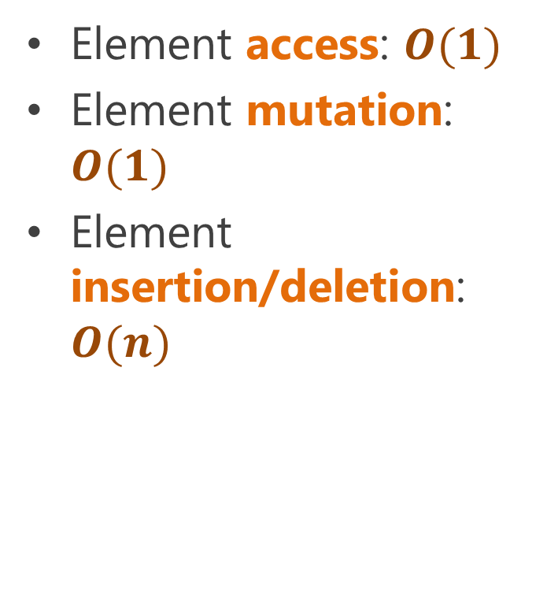
Dynamic arrays
pointer to current array
Element access: $O(1)$
Element mutation: $O(1)$
Element insertion/deletion: $O(n)$
original array
containing the data
updated
pointer
new array with extra element

Slide 11
Dynamic array in C#
public class DynamicArray {
object[] realArray
= new object[0];
// This overloads
// the [ ] operator
public object this[int index] {
get
{
return realArray[index];
}
set
{
realArray[index] = value;
}
}
// Add an element at position
void Add(int position,
object newValue)
{
object[] newArray
= new object[realArray.Length + 1];
for (int i = 0; i < position; i++)
newArray[i] = realArray[i];
newArray[position] = newValue;
for (int i = position+1;
i<newArray.Length; i++)
newArray[i] = realArray[i-1];
realArray = newArray;
}
// Removing an element is similar
// but won’t fit on the slide
}

Slide 12
Iterators
Provide a standard interface for iterating over items in a data structure
  In C# they’re used as the interface to foreach
Specify
  Where to start
  How to move to the next element
  How to know when you’re done
foreach (var e in collection) {
do_something(e);
}

Slide 13
Subroutines
You all know what subroutines are
  A.k.a procedures or functions
  Methods are a special case
They’re pieces of code that perform a service for other pieces of code
Control is passed
  First from the caller to the subroutine
  Them back to the caller, along with the return value
  After which, the call is done
call with arguments
return with result

Slide 14
Producer-consumer relationships
caller
What if you want to return multiple values?
Could return the values in an array or other sequence structure
  But that’s inefficient because you need to allocate new memory
What you wish is that the subroutine could “return” multiple times
  Once per result
call with arguments
subroutine
return array
caller

Slide 15
Coroutines
call with arguments
Way of letting a procedure return multiple values
Remember their place (and local variables) when they return
Can be resumed by caller to request another value
  Coroutine then continues where it left off
  Computes another value
  And returns it, again remembering its place
Eventually, they signal completion
  I.e. it returns for the last time
return result
resume
return next result
resume
return last result

Slide 16
Iterators in C#
Must return the magic type IEnumerable (or IEnumerable<T>)
Called using foreach
  Return values by saying “yield return value”
  Continue where they left off when when foreach requests the next value
  Continues until the coroutine exits
    I.e. it hits the last }
public IEnumerable
GetEnumerator() {
loop over all the elements
yield return current-element;
}

Slide 17
Iterator for dynamic arrays
public IEnumerator GetEnumerator() {
for (int i=0; i<realArray.Length; i++)
yield return realArray[i];
}
Now you can use a foreach statement to loop over a DynamicArray

Slide 18
Iterating over a DynamicArray
void Main() {
DynamicArray d;
… make d and fill it
with integers …
int sum = 0;
foreach (object e in d)
sum += (int)e;
}
class DynamicArray : IEnumerable {
public IEnumerator GetEnumerator()
{
for (int i=0;
i<realArray.Length;
i++)
yield return realArray[i];
}
… rest of the members …
}
d = { 2, 4, 6, 8 }
sum = 0

Slide 19
Iterating over a DynamicArray
void Main() {
DynamicArray d;
… make d and fill it
with integers …
int sum = 0;
foreach (object e in d)
sum += (int)e;
}
class DynamicArray : IEnumerable {
public IEnumerator GetEnumerator()
{
for (int i=0;
i<realArray.Length;
i++)
yield return realArray[i];
}
… rest of the members …
}
d = { 2, 4, 6, 8 }
sum = 0

Slide 20
Iterating over a DynamicArray
void Main() {
DynamicArray d;
… make d and fill it
with integers …
int sum = 0;
foreach (object e in d)
sum += (int)e;
}
class DynamicArray : IEnumerable {
public IEnumerator GetEnumerator()
{
for (int i=0;
i<realArray.Length;
i++)
yield return realArray[i];
}
}
d = { 2, 4, 6, 8 }
sum = 0
i = 0
realArray[i] = 2

Slide 21
Iterating over a DynamicArray
void Main() {
DynamicArray d;
… make d and fill it
with integers …
int sum = 0;
foreach (object e in d)
sum += (int)e;
}
class DynamicArray : IEnumerable {
public IEnumerator GetEnumerator()
{
for (int i=0;
i<realArray.Length;
i++)
yield return realArray[i];
}
}
d = { 2, 4, 6, 8 }
sum = 0
i = 0
realArray[i] = 2

Slide 22
Iterating over a DynamicArray
void Main() {
DynamicArray d;
… make d and fill it
with integers …
int sum = 0;
foreach (object e in d)
sum += (int)e;
}
class DynamicArray : IEnumerable {
public IEnumerator GetEnumerator()
{
for (int i=0;
i<realArray.Length;
i++)
yield return realArray[i];
}
}
d = { 2, 4, 6, 8 }
sum = 0
i = 0
realArray[i] = 2

Slide 23
Iterating over a DynamicArray
void Main() {
DynamicArray d;
… make d and fill it
with integers …
int sum = 0;
foreach (object e in d)
sum += (int)e;
}
class DynamicArray : IEnumerable {
public IEnumerator GetEnumerator()
{
for (int i=0;
i<realArray.Length;
i++)
yield return realArray[i];
}
}
d = { 2, 4, 6, 8 }
sum = 0
e = 2
i = 0
realArray[i] = 2

Slide 24
Iterating over a DynamicArray
void Main() {
DynamicArray d;
… make d and fill it
with integers …
int sum = 0;
foreach (object e in d)
sum += (int)e;
}
class DynamicArray : IEnumerable {
public IEnumerator GetEnumerator()
{
for (int i=0;
i<realArray.Length;
i++)
yield return realArray[i];
}
}
d = { 2, 4, 6, 8 }
sum = 2
e = 2
i = 0
realArray[i] = 2

Slide 25
Iterating over a DynamicArray
void Main() {
DynamicArray d;
… make d and fill it
with integers …
int sum = 0;
foreach (object e in d)
sum += (int)e;
}
class DynamicArray : IEnumerable {
public IEnumerator GetEnumerator()
{
for (int i=0;
i<realArray.Length;
i++)
yield return realArray[i];
}
}
d = { 2, 4, 6, 8 }
sum = 2
e = 2
i = 0
realArray[i] = 2

Slide 26
Iterating over a DynamicArray
void Main() {
DynamicArray d;
… make d and fill it
with integers …
int sum = 0;
foreach (object e in d)
sum += (int)e;
}
class DynamicArray : IEnumerable {
public IEnumerator GetEnumerator()
{
for (int i=0;
i<realArray.Length;
i++)
yield return realArray[i];
}
}
d = { 2, 4, 6, 8 }
sum = 2
e = 2
i = 0
realArray[i] = 2

Slide 27
Iterating over a DynamicArray
void Main() {
DynamicArray d;
… make d and fill it
with integers …
int sum = 0;
foreach (object e in d)
sum += (int)e;
}
class DynamicArray : IEnumerable {
public IEnumerator GetEnumerator()
{
for (int i=0;
i<realArray.Length;
i++)
yield return realArray[i];
}
}
d = { 2, 4, 6, 8 }
sum = 2
e = 2
i = 1
realArray[i] = 4

Slide 28
Iterating over a DynamicArray
void Main() {
DynamicArray d;
… make d and fill it
with integers …
int sum = 0;
foreach (object e in d)
sum += (int)e;
}
class DynamicArray : IEnumerable {
public IEnumerator GetEnumerator()
{
for (int i=0;
i<realArray.Length;
i++)
yield return realArray[i];
}
}
d = { 2, 4, 6, 8 }
sum = 2
e = 2
i = 1
realArray[i] = 4

Slide 29
Iterating over a DynamicArray
void Main() {
DynamicArray d;
… make d and fill it
with integers …
int sum = 0;
foreach (object e in d)
sum += (int)e;
}
class DynamicArray : IEnumerable {
public IEnumerator GetEnumerator()
{
for (int i=0;
i<realArray.Length;
i++)
yield return realArray[i];
}
}
d = { 2, 4, 6, 8 }
sum = 2
e = 2
i = 1
realArray[i] = 4

Slide 30
Iterating over a DynamicArray
void Main() {
DynamicArray d;
… make d and fill it
with integers …
int sum = 0;
foreach (object e in d)
sum += (int)e;
}
class DynamicArray : IEnumerable {
public IEnumerator GetEnumerator()
{
for (int i=0;
i<realArray.Length;
i++)
yield return realArray[i];
}
}
d = { 2, 4, 6, 8 }
sum = 2
e = 4
i = 1
realArray[i] = 4

Slide 31
Iterating over a DynamicArray
void Main() {
DynamicArray d;
… make d and fill it
with integers …
int sum = 0;
foreach (object e in d)
sum += (int)e;
}
class DynamicArray : IEnumerable {
public IEnumerator GetEnumerator()
{
for (int i=0;
i<realArray.Length;
i++)
yield return realArray[i];
}
}
d = { 2, 4, 6, 8 }
sum = 6
e = 4
i = 1
realArray[i] = 4

Slide 32
Iterating over a DynamicArray
void Main() {
DynamicArray d;
… make d and fill it
with integers …
int sum = 0;
foreach (object e in d)
sum += (int)e;
}
class DynamicArray : IEnumerable {
public IEnumerator GetEnumerator()
{
for (int i=0;
i<realArray.Length;
i++)
yield return realArray[i];
}
}
d = { 2, 4, 6, 8 }
sum = 6
e = 4
i = 1
realArray[i] = 4

Slide 33
Iterating over a DynamicArray
void Main() {
DynamicArray d;
… make d and fill it
with integers …
int sum = 0;
foreach (object e in d)
sum += (int)e;
}
class DynamicArray : IEnumerable {
public IEnumerator GetEnumerator()
{
for (int i=0;
i<realArray.Length;
i++)
yield return realArray[i];
}
}
d = { 2, 4, 6, 8 }
sum = 6
e = 4
i = 1
realArray[i] = 4

Slide 34
Iterating over a DynamicArray
void Main() {
DynamicArray d;
… make d and fill it
with integers …
int sum = 0;
foreach (object e in d)
sum += (int)e;
}
class DynamicArray : IEnumerable {
public IEnumerator GetEnumerator()
{
for (int i=0;
i<realArray.Length;
i++)
yield return realArray[i];
}
}
d = { 2, 4, 6, 8 }
sum = 6
e = 4
i = 2
realArray[i] = 6

Slide 35
Iterating over a DynamicArray
void Main() {
DynamicArray d;
… make d and fill it
with integers …
int sum = 0;
foreach (object e in d)
sum += (int)e;
}
class DynamicArray : IEnumerable {
public IEnumerator GetEnumerator()
{
for (int i=0;
i<realArray.Length;
i++)
yield return realArray[i];
}
}
d = { 2, 4, 6, 8 }
sum = 6
e = 4
i = 2
realArray[i] = 6

Slide 36
Iterating over a DynamicArray
void Main() {
DynamicArray d;
… make d and fill it
with integers …
int sum = 0;
foreach (object e in d)
sum += (int)e;
}
class DynamicArray : IEnumerable {
public IEnumerator GetEnumerator()
{
for (int i=0;
i<realArray.Length;
i++)
yield return realArray[i];
}
}
d = { 2, 4, 6, 8 }
sum = 6
e = 4
i = 2
realArray[i] = 6

Slide 37
Iterating over a DynamicArray
void Main() {
DynamicArray d;
… make d and fill it
with integers …
int sum = 0;
foreach (object e in d)
sum += (int)e;
}
class DynamicArray : IEnumerable {
public IEnumerator GetEnumerator()
{
for (int i=0;
i<realArray.Length;
i++)
yield return realArray[i];
}
}
d = { 2, 4, 6, 8 }
sum = 6
e = 6
i = 2
realArray[i] = 6

Slide 38
Iterating over a DynamicArray
void Main() {
DynamicArray d;
… make d and fill it
with integers …
int sum = 0;
foreach (object e in d)
sum += (int)e;
}
class DynamicArray : IEnumerable {
public IEnumerator GetEnumerator()
{
for (int i=0;
i<realArray.Length;
i++)
yield return realArray[i];
}
}
d = { 2, 4, 6, 8 }
sum = 12
e = 6
i = 2
realArray[i] = 6

Slide 39
Iterating over a DynamicArray
void Main() {
DynamicArray d;
… make d and fill it
with integers …
int sum = 0;
foreach (object e in d)
sum += (int)e;
}
class DynamicArray : IEnumerable {
public IEnumerator GetEnumerator()
{
for (int i=0;
i<realArray.Length;
i++)
yield return realArray[i];
}
}
d = { 2, 4, 6, 8 }
sum = 12
e = 6
i = 2
realArray[i] = 6

Slide 40
Iterating over a DynamicArray
void Main() {
DynamicArray d;
… make d and fill it
with integers …
int sum = 0;
foreach (object e in d)
sum += (int)e;
}
class DynamicArray : IEnumerable {
public IEnumerator GetEnumerator()
{
for (int i=0;
i<realArray.Length;
i++)
yield return realArray[i];
}
}
d = { 2, 4, 6, 8 }
sum = 12
e = 6
i = 3
realArray[i] = 6

Slide 41
Iterating over a DynamicArray
void Main() {
DynamicArray d;
… make d and fill it
with integers …
int sum = 0;
foreach (object e in d)
sum += (int)e;
}
class DynamicArray : IEnumerable {
public IEnumerator GetEnumerator()
{
for (int i=0;
i<realArray.Length;
i++)
yield return realArray[i];
}
}
d = { 2, 4, 6, 8 }
sum = 6
e = 4
i = 3
realArray[i] = 6

Slide 42
Iterating over a DynamicArray
void Main() {
DynamicArray d;
… make d and fill it
with integers …
int sum = 0;
foreach (object e in d)
sum += (int)e;
}
class DynamicArray : IEnumerable {
public IEnumerator GetEnumerator()
{
for (int i=0;
i<realArray.Length;
i++)
yield return realArray[i];
}
}
d = { 2, 4, 6, 8 }
sum = 6
e = 4

Slide 43
Iterating over a DynamicArray
void Main() {
DynamicArray d;
… make d and fill it
with integers …
int sum = 0;
foreach (object e in d)
sum += (int)e;
}
class DynamicArray : IEnumerable {
public IEnumerator GetEnumerator()
{
for (int i=0;
i<realArray.Length;
i++)
yield return realArray[i];
}
}
d = { 2, 4, 6, 8 }
sum = 6

Slide 44
Iterating over a DynamicArray
void Main() {
DynamicArray d;
… make d and fill it
with integers …
int sum = 0;
foreach (object e in d)
sum += (int)e;
}
class DynamicArray : IEnumerable {
public IEnumerator GetEnumerator()
{
for (int i=0;
i<realArray.Length;
i++)
yield return realArray[i];
}
}
d = { 2, 4, 6, 8 }
sum = 6

Slide 45
Linked lists
Break sequence into small objects (cells)
  Usually one per element
Each cell stores
  Value of one element
  Pointer to next object
Optional
  Keep pointers to the first, and/or last cells
Last cell
First cell
1
2
3

Slide 46
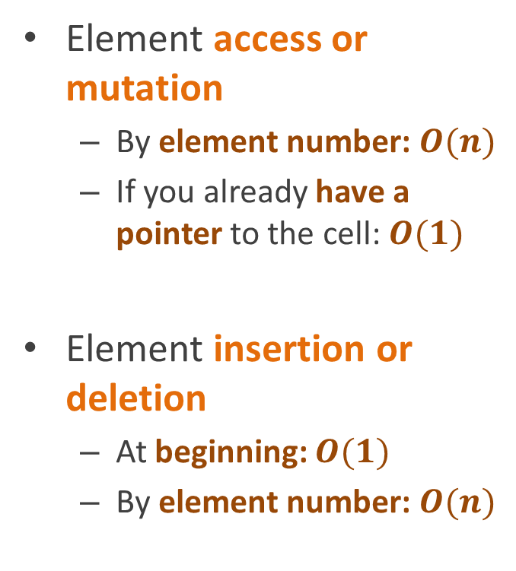
Linked lists
Element access or mutation
  By element number: $O(n)$
  If you already have a pointer to the cell: $O(1)$
Element insertion or deletion
  At beginning: $O(1)$
  By element number: $O(n)$
Last cell
First cell
1
2
3

Slide 47
Linked list in C#
Single field
  Points to first cell
Note: This uses a feature of C# we haven’t mentioned
You can put a class inside a class
And then it’s only visible to the enclosing class
class LinkedList : IEnumerable {
LinkedListCell first;
… other members …
class LinkedListCell
{
public object value;
public LinkedListCell next;
}
}

Slide 48
Linked list in C#
Code to find an element of the list given index
Property this[index]
  Overloads the [ ] operator so that you can say, e.g.:
  list[7] = list[8];
object this[int index]
{
get
{
var c = first;
for (int i = 0; i < index; i++)
c = c.next;
return c.value;
}
set
{
var c = first;
for (int i = 0; i < index; i++)
c = c.next;
c.value = value;
}
}

Slide 49
Linked list in C#
Adding an element at beginning of list is easy
Note: This uses another fancy C# feature:
Putting values of fields in constructor call
Wrapped in curly braces
void InsertBeginning(object value)
{
first = new LinkedListCell()
{
value = value,
next = first
};
}

Slide 50
Linked list in C#
Many applications manipulate list cells directly
If you’ve already found a cell, it’s easy to insert a new cell after it
void InsertAfter(LinkedListCell c,
object value)
{
c.next = new LinkedListCell()
{ value = value,
next = c.next };
}

Slide 51
Linked list in C#
Unfortunately, it’s hard to insert a cell before it
  Because you need to update the next pointer of the previous cell
  And you don’t know what that cell is
void InsertAfter(LinkedListCell c,
object value)
{
c.next = new LinkedListCell()
{ value = value,
next = c.next };
}

Slide 52
Linked list in C#
Adding a general element is ugly
  Special-case insertion at beginning
  Otherwise search for element before the place we’re inserting
  Insert after that
void Insert(int position, object value) {
if (position == 0)
InsertBeginning(value);
else {
LinkedListCell c = first;
for (int i = 0; i < position-1; i++)
c = c.next;
InsertAfter(c);
}

Slide 53
Iterator for LinkedLists
public IEnumerator GetEnumerator() {
var c = first;
while (c != null) {
yield return c.value;
c = c.next;
}
}

Slide 54
Doubly linked lists
Linked lists make it easy to find the cell after a given cell but not before
By adding a second pointer to the cell that points to the previous cell, we can make it easy to
  Move forward and backward
  Insert elements before a given cell (not just after)
1
2
3

Slide 55
Doubly-linked list insertion
(note: this is a popular interview question)
class DLLCell
{
public object value;
public DLLCell prev;
public DLLCell next;
}
void InsertBefore(DLLCell c, object newValue)
{
InsertBetween(c.prev, c, newValue);
}
void InsertAfter(DLLCell c, object newValue) {
InsertBetween(c, c.next, newValue);
}
void InsertBetween(DLLCell before,
DLLCell after,
object newValue)
{
var newCell = new DLLCell()
{ value = newValue,
prev = before,
next = after };
before.next = after.prev = newCell;
}

Slide 56
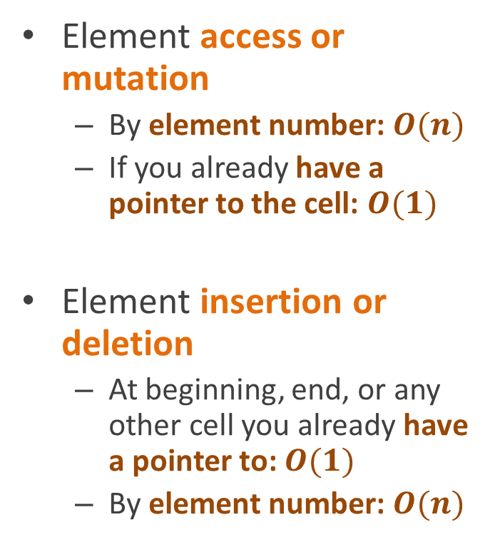
Doubly linked lists
Element access or mutation
  By element number: $O(n)$
  If you already have a pointer to the cell: $O(1)$
Element insertion or deletion
  At beginning, end, or any other cell you already have a pointer to: $O(1)$
  By element number: $O(n)$
Last cell
First cell
1
2
3

Slide 57
The .NET list interfaces
.NET and C# provide two built-in interfaces for the List abstract data type
IList is a list of arbitrary objects
  i.e. can contain any kind of data
IList<T> is an IList specialized only contain data of type T

Slide 58
IList interface methods
int Add(object newValue)
Adds an item to the IList. Returns the position where it was added
void Clear()
Removes all items from the IList.
bool Contains(object value)
Determines whether the IList contains a specific value.
void CopyTo(object[] array,
int position)
Copies the elements of the IList to an array, starting at a particular position in the destination array
IEnumerator GetEnumerator()
Returns an enumerator that iterates through a collection.
int IndexOf(object value)
Determines the index of a specific item in the IList.
void Insert(int position,
object newValue)
Inserts an item to the IList at the specified position.
void Remove(object value)
Removes the first occurrence of a specific object from the IList.
void RemoveAt(int position)
Removes the IList item at the specified index.

Slide 59
IList interface properties
int Count { get; }
Returns the number
of items in the list
bool IsFixedSize
{ get; }
Tells whether elements can be added and deleted from the list.
object this[int index]
{ get; set; }
Overloads the [ ] operator

Slide 60
Generic versions
.NET also includes typed versions of most of its collection-related interfaces
So you can use them to define a DynamicArray<T> class, if you like
IEnumerator<T>
IEnumerable<T>
IList<T>
IStack<T>
IQueue<T>

Slide 61
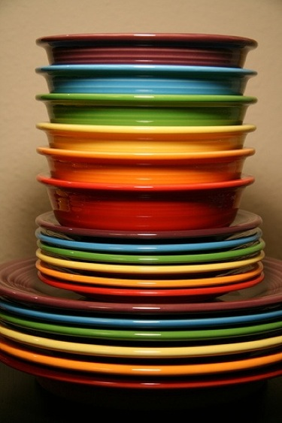
Stacks
Stacks are a special kind of sequence
Addition and deletion are restricted to the beginning of the sequence
  Or you can think of it as restricted to the end, it doesn’t really make any difference
So stacks can be implemented using any sequence data structure
From flickr user matthewpiatt

Slide 62
Implementing a stack with an array
class ArrayStack {
object[] values = new object[100];
int top = 0;
void Push(object v) {
values[top++] = v;
}
object Pop() {
return values[--top];
}
bool IsEmpty {
get { return top==0; }
}
}

Slide 63
Implementing a stack with an array
var s = new ArrayStack();
top = 0
values

Slide 64
Implementing a stack with an array
var s = new ArrayStack();
s.Push(1);
top = 1
1
values

Slide 65
Implementing a stack with an array
var s = new ArrayStack();
s.Push(1);
s.Push(2);
top = 2
2
1
values

Slide 66
Implementing a stack with an array
var s = new ArrayStack();
s.Push(1);
s.Push(2);
s.Push(3);
top = 3
3
2
1
values

Slide 67
Implementing a stack with an array
var s = new ArrayStack();
s.Push(1);
s.Push(2);
s.Push(3);
s.Pop() // returns 3
top = 2
3
2
1
values

Slide 68
Implementing a stack with an array
var s = new ArrayStack();
s.Push(1);
s.Push(2);
s.Push(3);
s.Pop() // returns 3
s.Pop() // returns 2
top = 1
3
2
1
values

Slide 69
Implementing a stack with an array
var s = new ArrayStack();
s.Push(1);
s.Push(2);
s.Push(3);
s.Pop() // returns 3
s.Pop() // returns 2
s.Pop() // returns 1
top = 0
3
2
1
values

Slide 70
Implementing a stack with an array
var s = new ArrayStack();
s.Push(1);
s.Push(2);
s.Push(3);
s.Pop() // returns 3
s.Pop() // returns 2
s.Pop() // returns 1
s.IsEmpty // true
top = 0
3
2
1
values

Slide 71
Implementing a stack with a linked list
public class LLStack {
LLCell top = null;
void Push(object v) {
top = new LLCell(v, top);
}
object Pop() {
LLCell oldTop = top;
top = top.next;
return oldTop.value;
}
bool IsEmpty {
get { top==null; }
}
}
public class LLCell {
public object value
public LLCell next;
public LLCell(object v, LLCell n) {
value = v;
next = n;
}
}

Slide 72
Implementing a stack with a linked list
s = new LLStack();
null
top

Slide 73
Implementing a stack with a linked list
s = new LLStack();
s.Push(1);
top
1
null

Slide 74
Implementing a stack with a linked list
s = new LLStack();
s.Push(1);
s.Push(2);
top
2
1
null

Slide 75
Implementing a stack with a linked list
s = new LLStack();
s.Push(1);
s.Push(2);
s.Push(3);
top
3
2
1
null

Slide 76
Implementing a stack with a linked list
s = new LLStack();
s.Push(1);
s.Push(2);
s.Push(3);
s.Pop(); // returns 3
top
2
1
null

Slide 77
Implementing a stack with a linked list
s = new LLStack();
s.Push(1);
s.Push(2);
s.Push(3);
s.Pop(); // returns 3
s.Pop(); // returns 2
top
1
null

Slide 78
Implementing a stack with a linked list
s = new LLStack();
s.Push(1);
s.Push(2);
s.Push(3);
s.Pop(); // returns 3
s.Pop(); // returns 2
s.Pop(); // returns 1
null
top

Slide 79
Implementing a stack with a linked list
s = new LLStack();
s.Push(1);
s.Push(2);
s.Push(3);
s.Pop(); // returns 3
s.Pop(); // returns 2
s.Pop(); // returns 1
s.IsEmpty // true
null
top

Slide 80

Queues
From the French for “line” or “tail”
A specialized type of sequence where
  Additions can only be performed at the “end” or “tail”
  Removals can only be performed at the “beginning” or “head”
flickr user DaveKav

Slide 81
Queues
Like stacks, queues give their add and delete operations funny names
Enqueue(item)
Adds item to the end of the queue
Dequeue()
Removes item at the head of the queue and returns it
flickr user DaveKav

Slide 82
Queues
Like stacks, queues can be implemented using any sequence structure
Arrays
Linked lists
flickr user DaveKav

Slide 83
Simple queue implementation using a static array
One simple way to implement a queue is to use a fixed-size array
  Limits number of elements that can be in the queue
Also uses two fields to keep track of data in the queue
  Head: index in the array of the next element to dequeue
  Tail: index in the array of where the next enqueued element should be stored
object[] data = new object[100];
int head;
int tail;
void Enqueue(object o) {
data[tail] = o;
tail = (tail+1)%data.Length;;
}
object Dequeue() {
object item = data[head];
head = (head+1)%data.Length;
return item;
}

Slide 84
Array-based queue
(with a capacity of 3 elements)
Head
Tail

Slide 85
Array-based queue
Enqueue(0)
0
Head
Tail

Slide 86
Array-based queue
Enqueue(0)
Enqueue(1)
0
1
Head
Tail

Slide 87
Array-based queue
Enqueue(0)
Enqueue(1)
Dequeue()
  Returns 0
0
1
Head
Tail

Slide 88
Array-based queue
Enqueue(0)
Enqueue(1)
Dequeue()
  Returns 0
Enqueue(2)
0
1
2
Head
Tail

Slide 89
Array-based queue
Enqueue(0)
Enqueue(1)
Dequeue()
  Returns 0
Enqueue(2)
Enqueue(3)
0
1
2
3
Head
Tail

Slide 90
Array-based queue
Enqueue(0)
Enqueue(1)
Dequeue()
  Returns 0
Enqueue(2)
Enqueue(3)
Dequeue()
  Returns 1
0
1
2
3
Head
Tail

Slide 91
Array-based queue
Enqueue(0)
Enqueue(1)
Dequeue()
  Returns 0
Enqueue(2)
Enqueue(3)
Dequeue()
  Returns 1
Enqueue(4)
4
1
2
3
Head
Tail

Slide 92
Deques
Pronounced “deck”
Double-ended queue
Specialized sequence in which additions and deletions
  Can be made on either side
  But only on the sides

Slide 93
Deques
Deques generalize stacks and queues
Behave like a stack
  If you only add/remove from one side
Behave like a queue
  If you add from one side
  And remove from the other

Slide 94
Reading
CLRS, Chapter 10
(Elementary Data Structures)
Sections 1-3
  11.1 Stacks and queues
  11.2 Linked lists
  11.3 Implementing pointers and objects

Slide 95
Assignment 1
Implement queues
  Using arrays
  And linked lists
Do a fuller implementation than discussed in class
  Extra methods, like IsEmpty
  Should check for error conditions and throw appropriate exceptions
Implement deques using doubly-linked lists
Test using automated testing tools in Visual Studio
  We provide a partial set of test cases
  We will grade with a larger set
  Grade will be number of tests passed
Out: Friday, April 12
  Due Monday, April 22, 11:59pm
  Do not wait until the last minute

